Slide 1
Internet of Things Analytics
Advances in Data Science and Architecture
Team 8
Ankita Suresh Shanbhag
Vignesh Karthikeyan
Sriniketan G.S

Slide 2
Problem Statement
We have the weather station data from, for this analysis we have chosen Boston, MA and weather data from the year 2008 to present. We are going to forecast the weather for the next few days. Our Web application will display the forecast for the future period and will get updated every day.
We are forecasting the future weather using the past data so we have used AR + I + MA modeling (ARIMA) for the forecast as the future data depends only on the past trend. And we have tried to observe the trend and seasonal components out of our data and the trend represents the gradual increase in temperature over the year, which might be due to global warming.

Slide 3
Column | Type
Timestamp | Date
EST | character
Max.TemperatureF | numeric
Mean.TemperatureF | numeric
Min.TemperatureF | numeric
Max.Dew.PointF | numeric
MeanDew.PointF | numeric
Min.DewpointF | numeric
Max.Humidity | numeric
Mean.Humidity | numeric
Min.Humidity | numeric
Max.Sea.Level.PressureIn | numeric
Mean.Sea.Level.PressureIn | numeric
Min.Sea.Level.PressureIn | numeric
Max.VisibilityMiles | numeric
Mean.VisibilityMiles | numeric
Min.VisibilityMiles | numeric
Max.Wind.SpeedMPH | numeric
Mean.Wind.SpeedMPH | numeric
Max.Gust.SpeedMPH | numeric
PrecipitationIn | numeric
CloudCover | numeric
Events | character
WindDirDegrees.br... | character

Slide 4
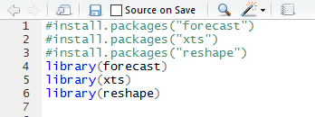

Visualization and Analysis

Slide 5
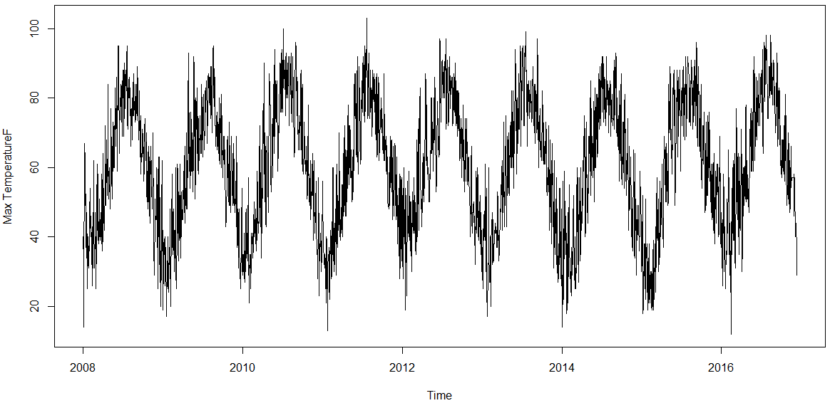
It can be observed that there is a seasonality component to data but the trend is not clearly visible so on decomposing we get.

Slide 6
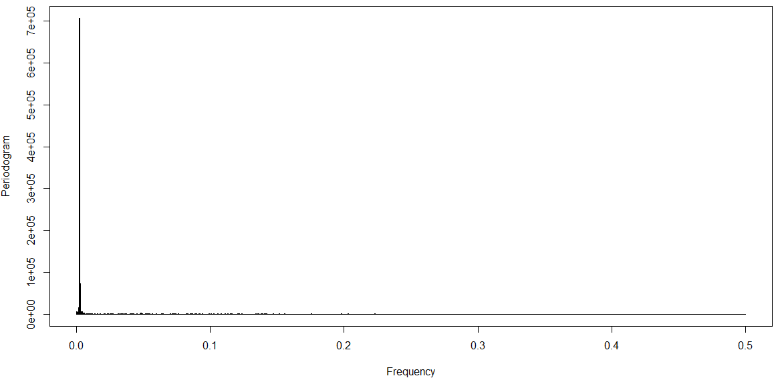
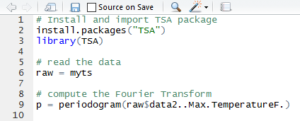
Detect the seasonality using Fourier transform

Slide 7
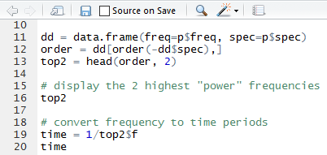
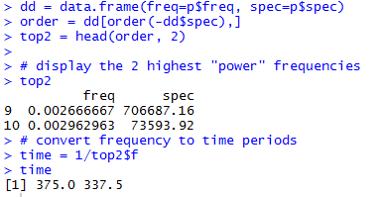
Code to get frequency
The out put we get

Slide 8
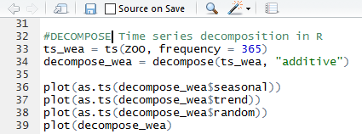
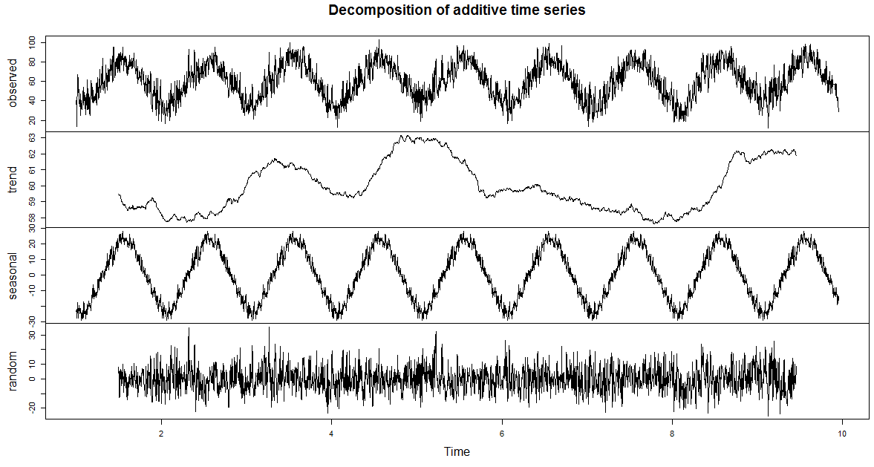
Code to decompose
The out put we get

Slide 9

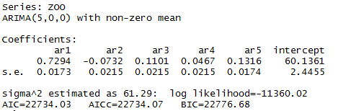

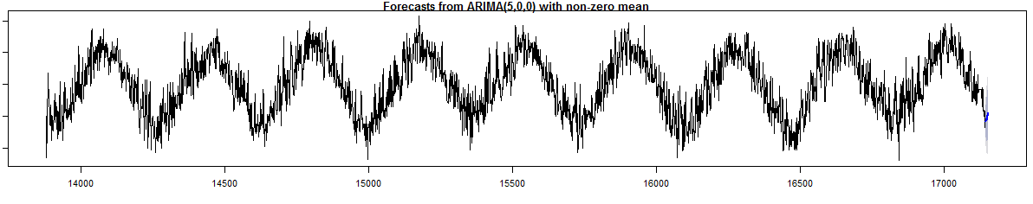
Code to get (p,d,q)
The out put we get
Code to get forecast
The out put we get

Slide 10
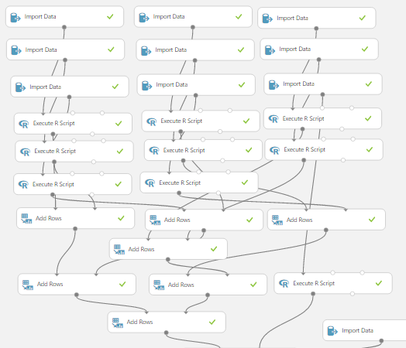
Import data

Slide 11
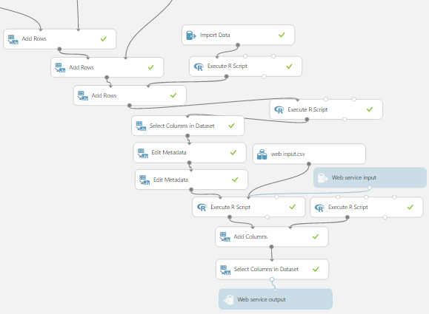
ARIMA Model

Slide 12
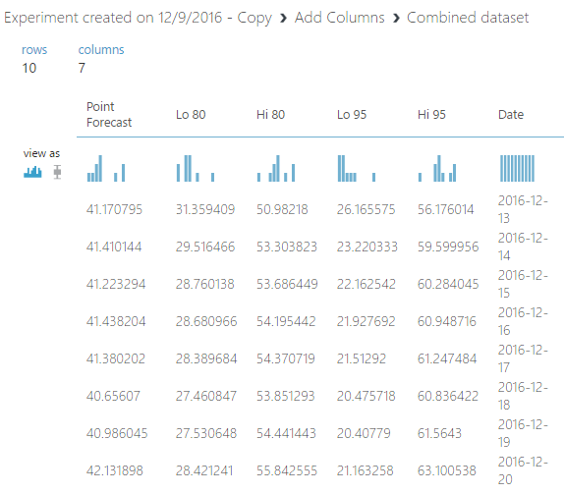
The forecast Data we get is:- (snap shot taken on 12 Dec 2016)

Slide 13
Add other weather components
Weather component | (p,d,q)
Mean.TemperatureF | (9,0,0)
MeanDew.PointF | (1,0,1)
Mean.Humidity | (2,0,2)
Mean.VisibilityMiles | (0,1,2)
PrecipitationIn | (0,0,1)
CloudCover | (0,0,1)
Events | Cannot be computed

Slide 14
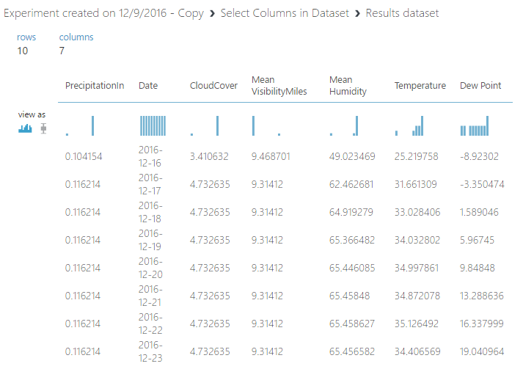
forecast the weather for next 10 days

Slide 15
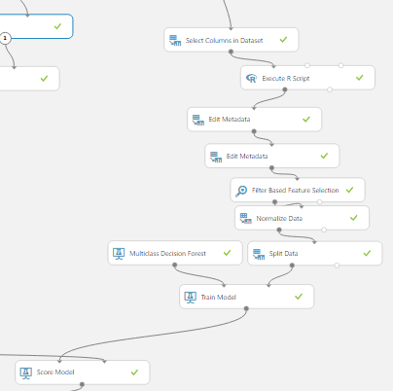
Events : compute
Weather component | (p,d,q) | Variable Type
Mean.TemperatureF | (9,0,0) | Independent
MeanDew.PointF | (1,0,1) | Independent
Mean.Humidity | (2,0,2) | Independent
Mean.VisibilityMiles | (0,1,2) | Independent
PrecipitationIn | (0,0,1) | Independent
CloudCover | (0,0,1) | Independent
Events | Perform Regression | Dependent

Slide 16
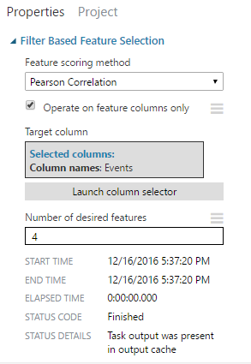
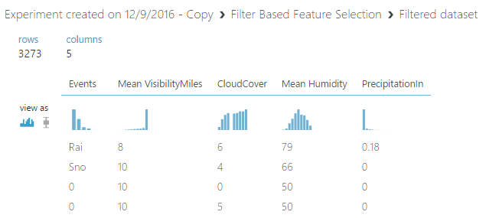
Filter out only the necessary variables

Slide 17
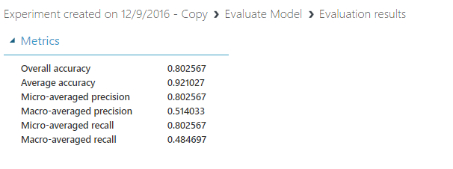
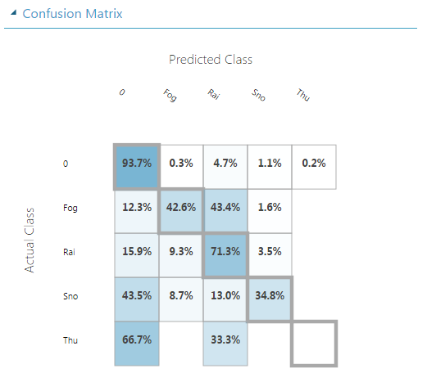
Score and Evaluate the model

Slide 18
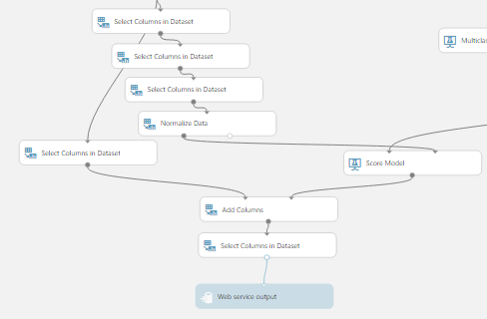
Predict the ‘Events’ using dependent variable mentioned above

Slide 19
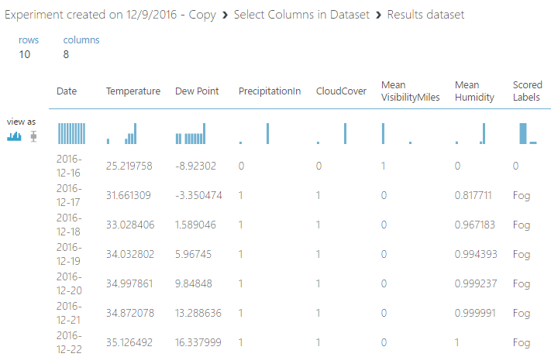
Forecast for 10 days into the future

